Slide 1







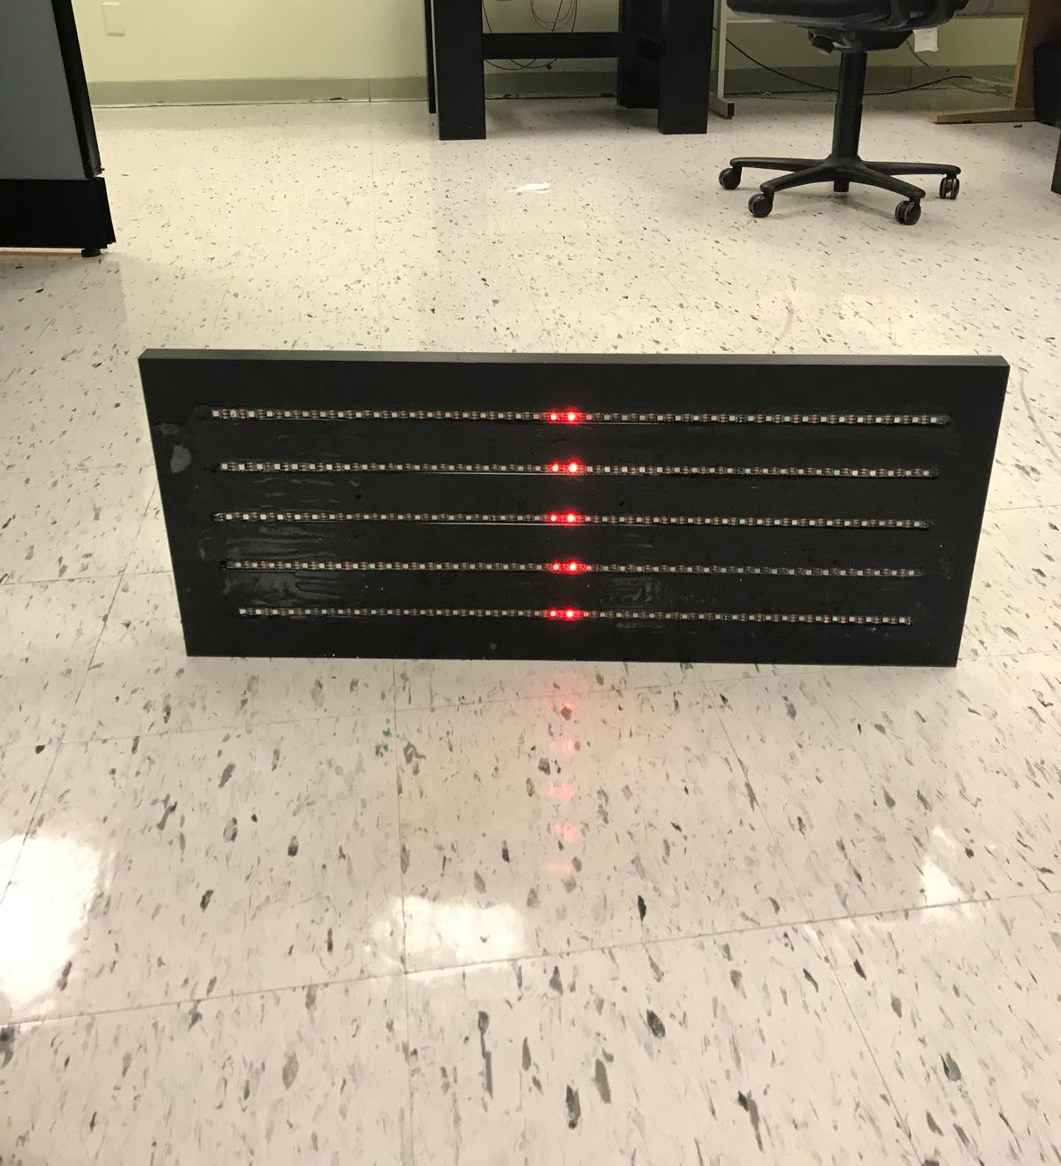
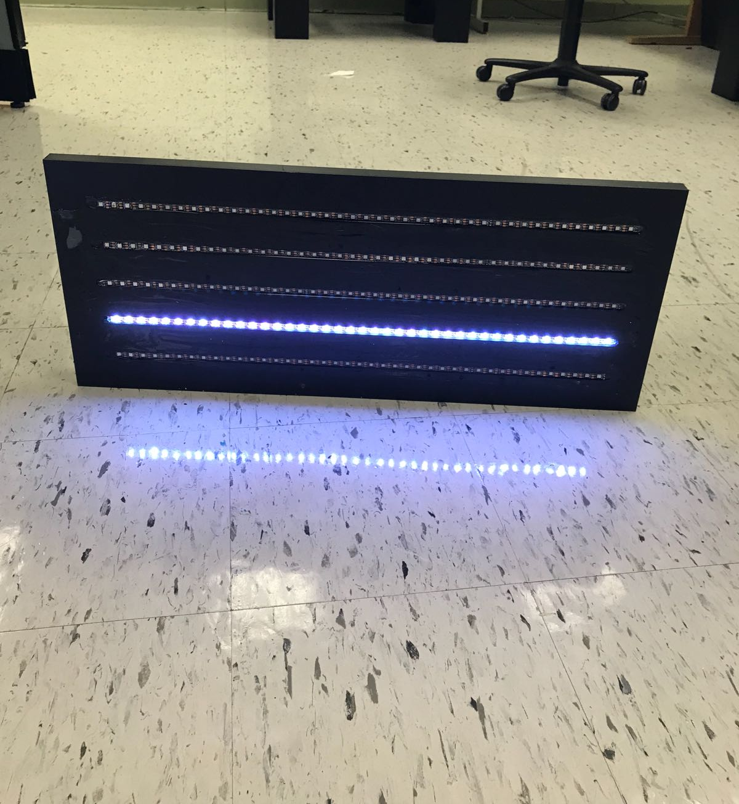
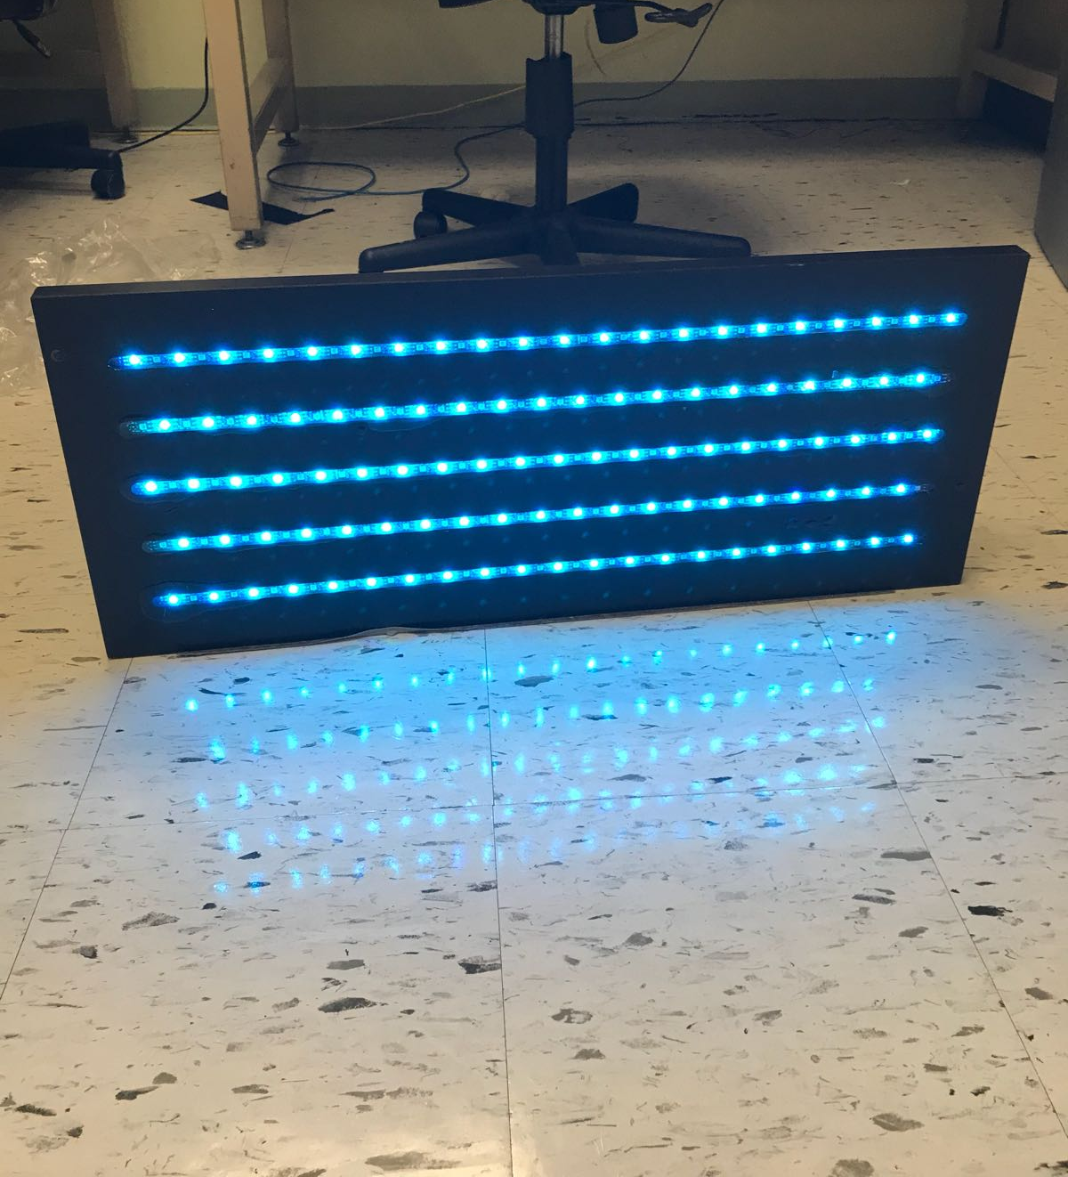
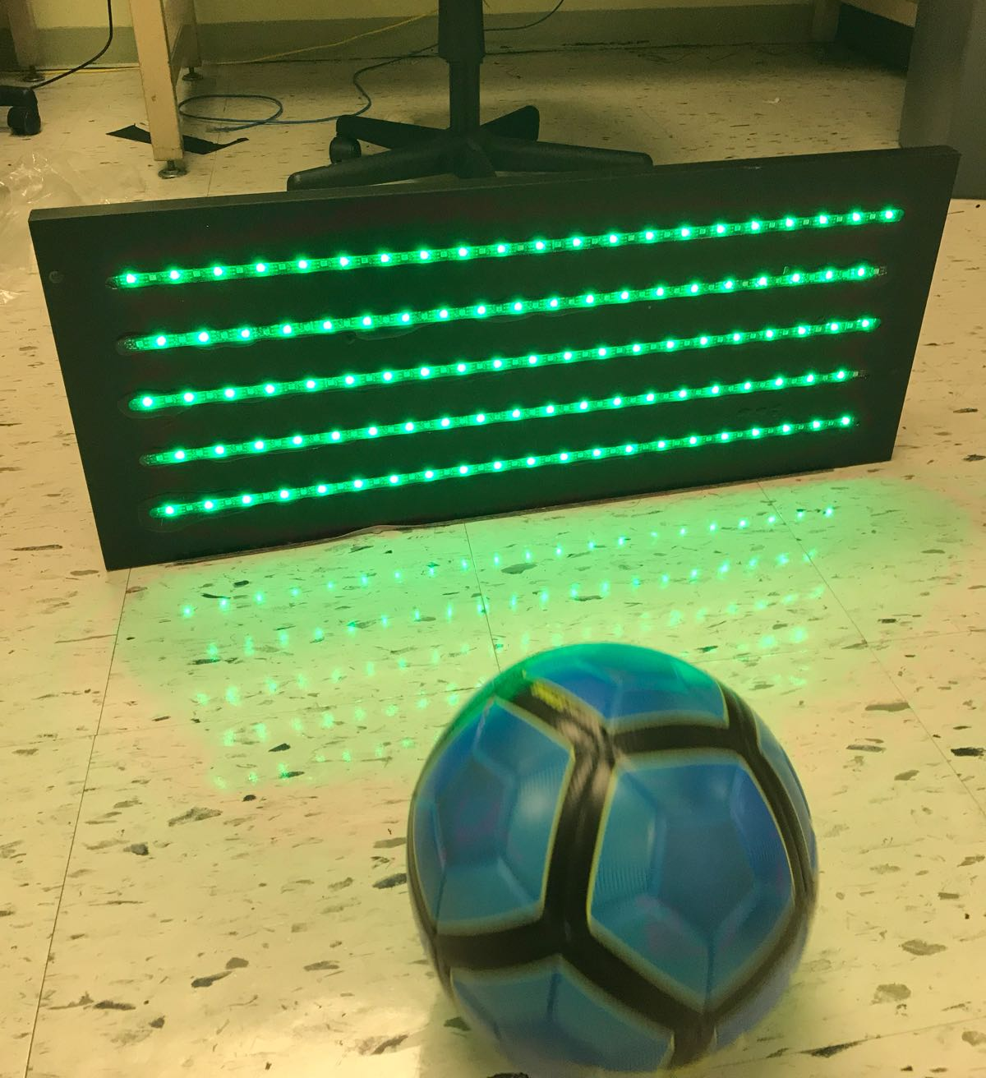
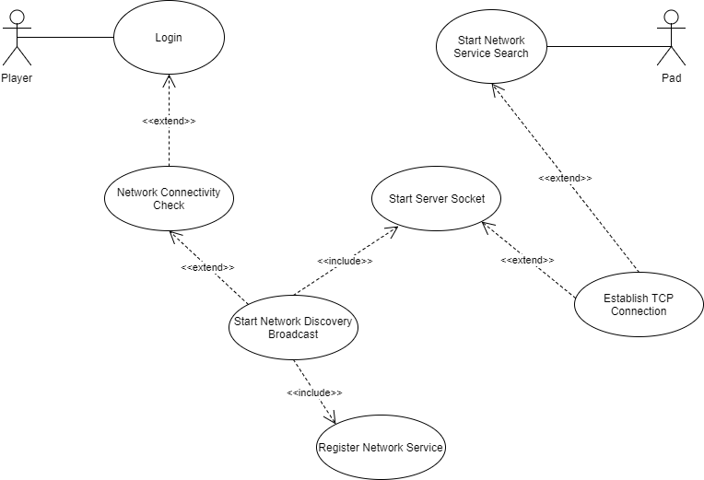
School of Computing & Information Sciences
CIS 4911, Fall, 2017
Skill Court(Soccer Training System) 9.0
Student: Nicolas Dabdoub, Florida International University
Mentor: Guðmundur Traustason, Product Owner
Professor: Masoud Sadjadi, Florida International University
Problem
With the growing integration of technology into sports:
Players and Coaches want to be able to record their practices.
Collect Statistics and have easily observable, analyzable data.
More creative methods to simulate realistic or more complex drills.
Solution
Skill Court 9.0 provides direct path to integrate technology into soccer
Connected to the app are LED pads which record hit/miss data when hit or not hit with a soccer ball.
Players can train, improve, and find new drills on themselves when without a team or coaching staff
Current System
Skill Court connects to Arduino pads dynamically
Each pad uses zeroConfig for Multicast DNS Service Discovery
Each Raspberry pi has a vibration sensor which uses SPI to communicate with the pi.
Screenshots
Requirements
The pads must display:
A red vertical line of LEDs informing the user that the pad is connecting
White horizontal lines when the pad is connected to the app.
Blue rectangle of lights once the game is started indicating the pad to be hit.
Green rectangle of lights indicating the correct pad has been hit.
System Design
SkillCourt uses Java which was developed with the Android Studio’s development environment. The Android App connects directly to Arduino pads which receive instructions on how to light up and send on hit notifications back to the Android App. The pi’s uses python and contains one firmware script that pulls from 3 libraries to controls the pads These “hits” are registered by the app and data on recorded during the games are saved to Firebase in real time.
Implementation
Each pad has a Raspberry pi with a vibration sensor mounted on the back.
Each pad as shown above has 5 horizontal lines of LED multicolored lights.
1 firmware python script controls all the actions done by the pads and receives commands from the SkillCourt app.
Verification
To verify the implementation was successful both unit and integration testing was used. However integration testing was more useful since once the pi’s were connected to the app multi-threading and communication issues became the source of the most errors/bugs.
Use Case Diagram
Summary
SkillCourt v9.0 now allows for dynamic linking of the pads to the app
Users no longer have to be confused when connecting and configuring app to it’s devices
Players/Coaches are now able to focus more on improving rather than learning the app
Acknowledgement
The material presented in this poster is based upon the work supported by Felix Garcia and Michael Thompson I am thankful to the help that I received from my group members, Leonardo Varon and Joshua McLendon.
Notes:
1

